Slide 1


Kepler, Provenance, and other Scientific Workflow Systems
Matthew B. Jones
Jim Regetz
National Center for Ecological Analysis and Synthesis (NCEAS)
University of California Santa Barbara
NCEAS Synthesis Institute
June 28, 2013
Notes:
NCEAS is an NSF funded research center whose mission is to advance the state of ecological knowledge through synthetic, cross-cutting studies using existing data. Soon after NCEAS formed it became obvious that there was a large need for informatics tools that support synthetic research.

Slide 2
Diverse Analysis and Modeling
Wide variety of analyses used in ecology and environmental sciences
Statistical analyses and trends
Rule-based models
Dynamic models (e.g., continuous time)
Individual-based models (agent-based)
many others
Implemented in many frameworks
implementations are black-boxes
learning curves can be steep
difficult to couple models

Slide 3
Scientific workflows
Workflow as instance
The workflow is the process!
Two major approaches
Scripted workflows
in R, or Python, or bash, or ...
Dedicated workflow engines
Kepler and others
Let’s focus on this for a while
Notes:
But in the computer, we can create workflow instances, each of which is the complete and self-contained expression of some end-to-end analysis.

Slide 4
Goals
Produce an open-source scientific workflow system
design, share, and execute scientific workflows
Support scientists in a variety of disciplines
e.g., biology, ecology, oceanography, astronomy
Important features
access to scientific data
works across analytical packages
simplify distributed computing
clear documentation
effective user interface
provenance tracking for results
model archiving and sharing

Slide 5
Kepler use cases represent many science domains
Ecology
SEEK: Ecological Niche Modeling
COMET: environmental science
REAP: Parasite invasions using sensor networks
Geosciences
GEON: LiDAR data processing
GEON: Geological data integration
Molecular biology
SDM: Gene promoter identification
ChIP-chip: genome-scale research
CAMERA: metagenomics
Oceanography
REAP: SST data processing
LOOKING: ocean observing CI
NORIA: ocean observing CI
ROADNet: real-time data modeling
Ocean Life project
Physics
CPES: Plasma fusion simulation
FermiLab: particle physics
Phylogenetics
ATOL: Processing Phylodata
CiPRES: phylogentic tools
Chemistry
Resurgence: Computational chemistry
DART (X-Ray crystallography)
Library Science
DIGARCH: Digital preservation
Cheshire digital library: archival
Conservation Biology
SanParks: Thresholds of Potential Concerns

Slide 6
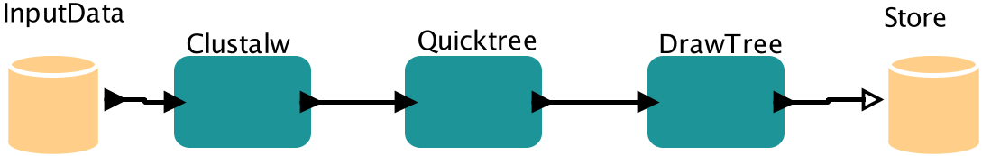
Anatomy of a Kepler Workflow
Actors
Tokens
int, string, record{..}, array[..], ..
Channels
Ports

Slide 7
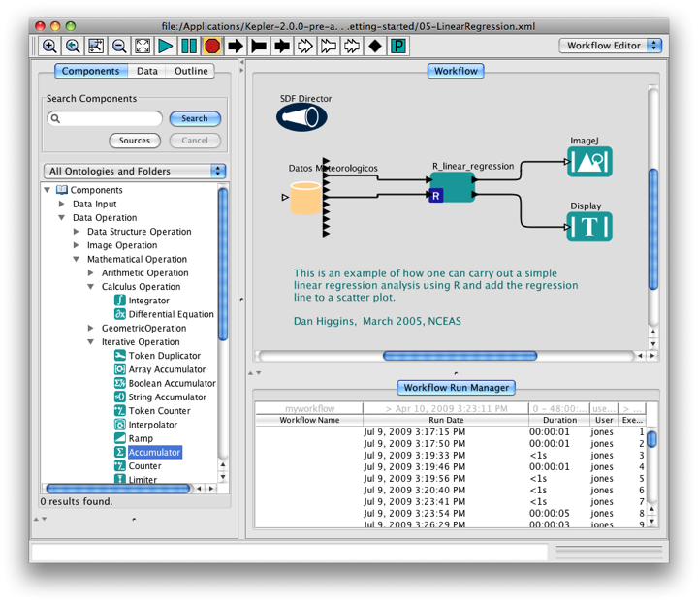
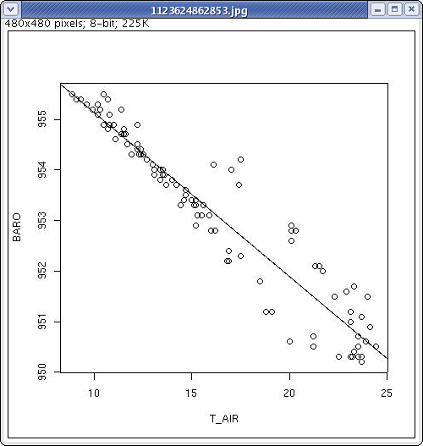
Kepler scientific workflow system
Run Management
Each execution recorded
Provenance of derived data recorded
Can archive runs and derived data
Data source from
repository
R processing script
res <- lm(BARO ~ T_AIR)
res
plot(T_AIR, BARO)
abline(res)

Slide 8
A Simple Kepler Workflow
Component Tab
Searchable Component List
Workflow Run Manager

Slide 9
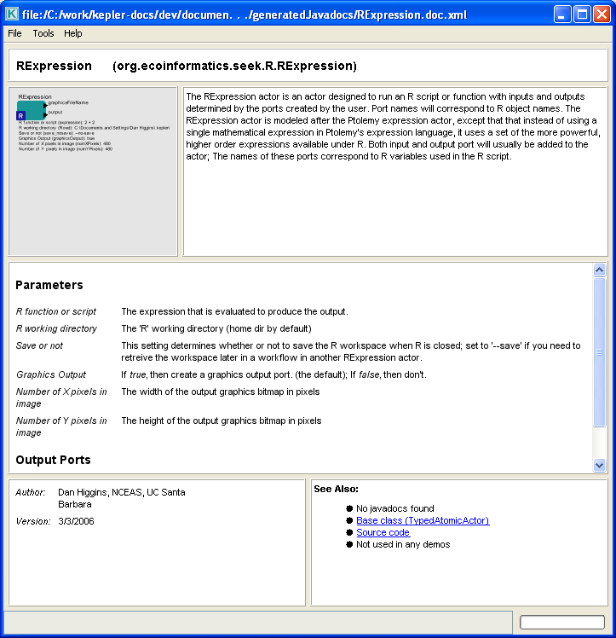
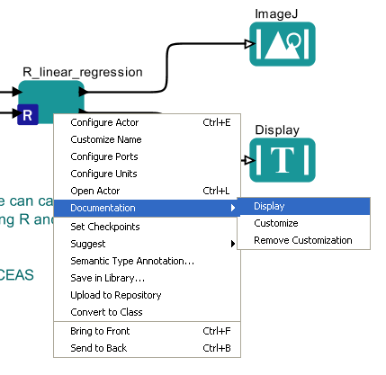
Component Documentation

Slide 10
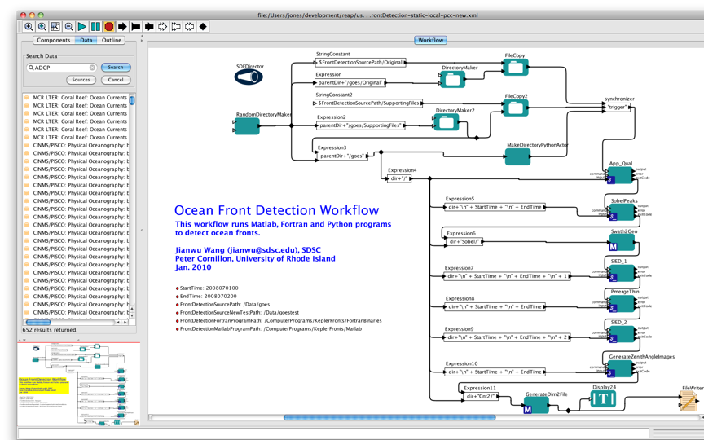
Data preparation
FORTRAN code
MATLAB code

Slide 11
Data Access

Slide 12
Accessing Data in Kepler
File system (e.g., CSV files)
Catalog searches (e.g., KNB)
Remote databases (e.g., PostgresQL)
Web services
Data access protocols (e.g., OPeNDAP)
Streaming data (e.g., DataTurbine)
Specialized repositories (e.g., SRB)
etc., and extensible

Slide 13
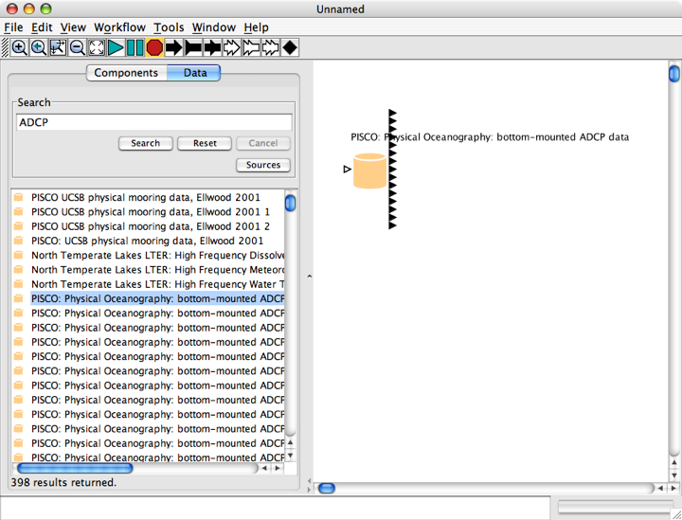
Direct Data Access to Data Repositories
Search for metadata term (“ADCP”)
Drag to workflow area to create datasource
398 hits for ‘ADCP’ located in search

Slide 14
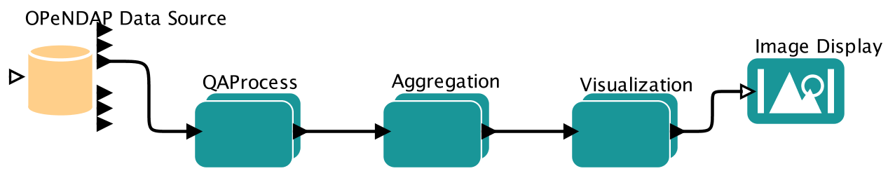



OPeNDAP
Directly access OPeNDAP servers
Apply OPeNDAP constraints for remote data subsetting
Current work: searchable catalogs across OPeNDAP servers

Slide 15
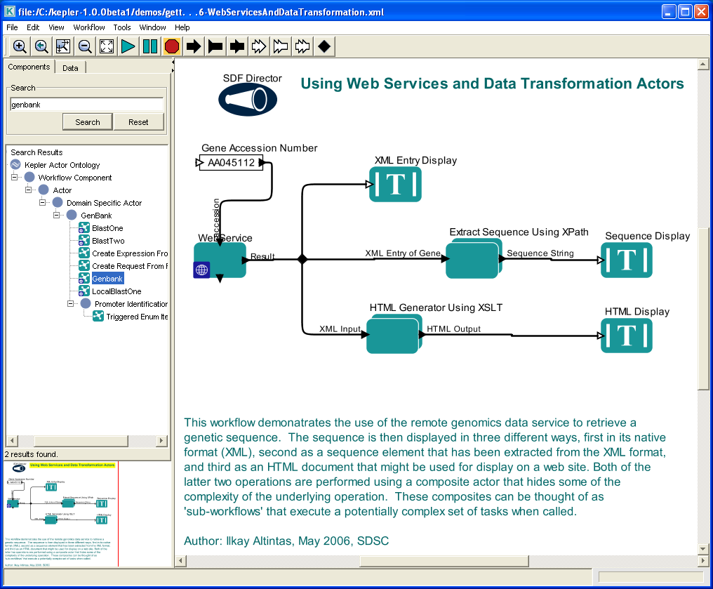
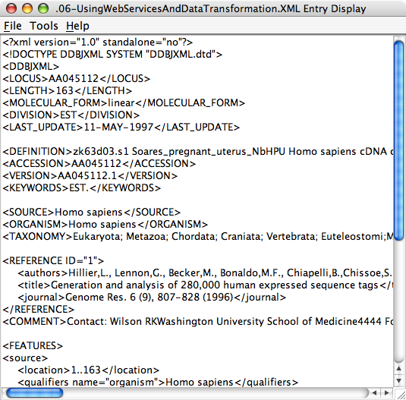
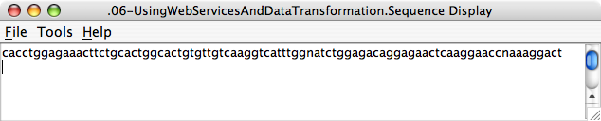
Gene sequences via web services
Gene sequence returned
in XML format
Extracted sequence
can be returned for
further processing
Web service executes
remotely (e.g., in Japan)
This entire workflow can be
wrapped as a re-usable component
so that the details of extracting
sequence data are hidden unless
needed.

Slide 16
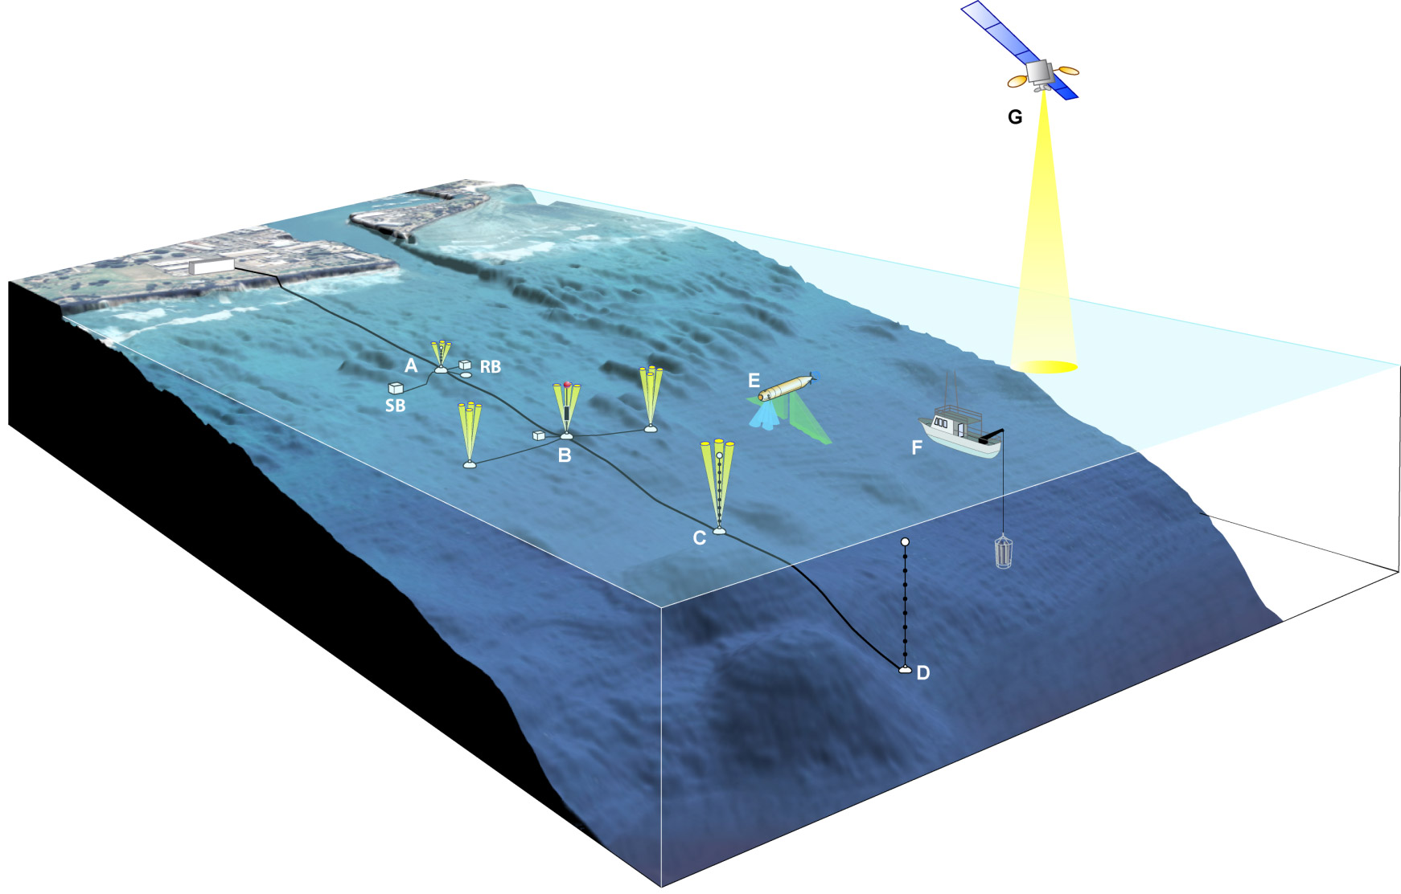
Benthic Boundary Layer Project: Kilo Nalu, Hawaii
Benthic Boundary Layer Geochemistry and Physics at the Kilo Nalu Observatory
G. Pawlak, M. McManus, F. Sansone, E. De Carlo, A. Hebert and T. Stanton
NSF Award #OCE-0536607-000
Research instruments are part of cabled-array at the Kilo Nalu Observatory
Deployed off of Point Panic, Honolulu Harbor, Hawai’i
Goal: Measure the interactions between physical oceanographic forcing, sediment alteration, and modification of sediment-seawater fluxes

Slide 17
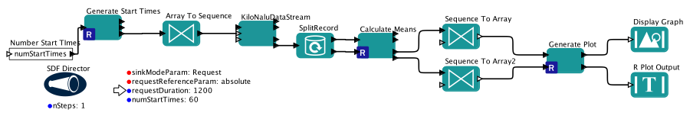
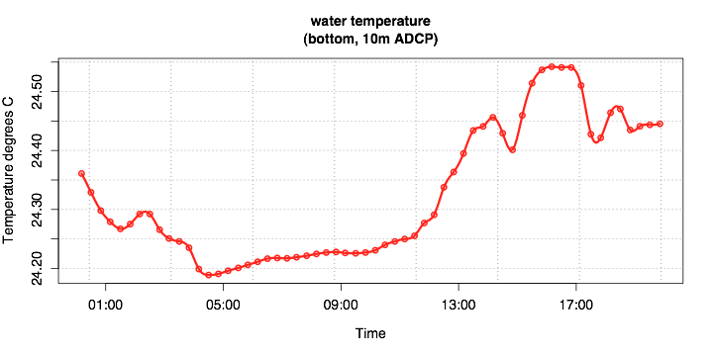
Accessing sensor streams at Kilo Nalu
Support application scripts
in R, Matlab, etc.
now <- Sys.time()
Epoch <- now - as.numeric(now)
timeval <-Epoch + timestamps
posixtmedian = median(timeval)
mediantime = as.numeric(posixtmedian)
meantemp = mean(data)
Streaming Data
from observatory
DataTurbine Server
Modular components,
easily saved and shared
Graphs and derived
data can be
archived and displayed

Slide 18
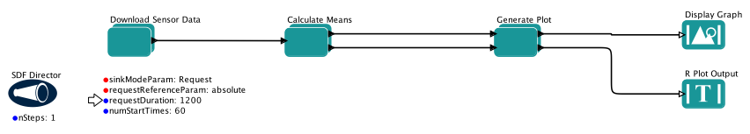
Composite actors aid comprehension

Slide 19
Composite actors aid comprehension
Save components
for later re-use
Share components
via external repositories

Slide 20
Workflow archiving and sharing

Slide 21
Archiving isn’t just for data...
Kepler can archive and version:
Analysis code and workflows
Results and derived data
e.g., data tables, graphs, maps
Derived data lineage
What data were used as inputs
What processes were used to generate the derived products

Slide 22
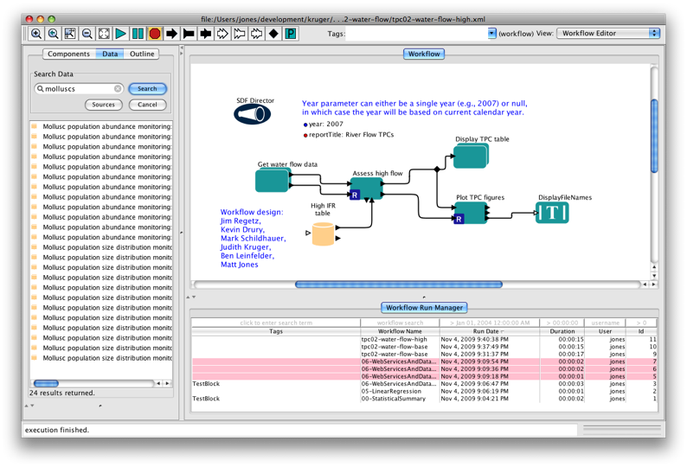
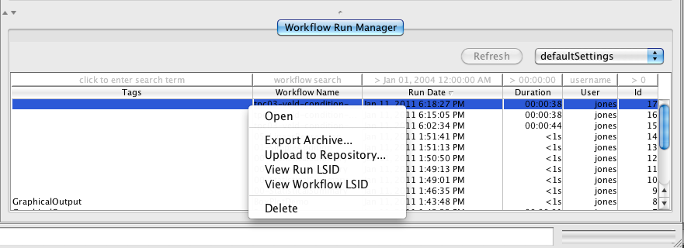
Run Management & Sharing
Provenance subsystem monitors data tokens

Slide 23
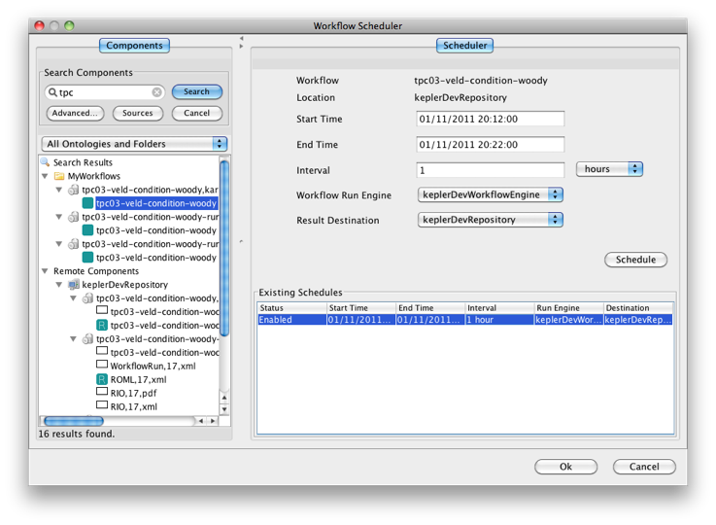
Scheduling remote execution

Slide 24
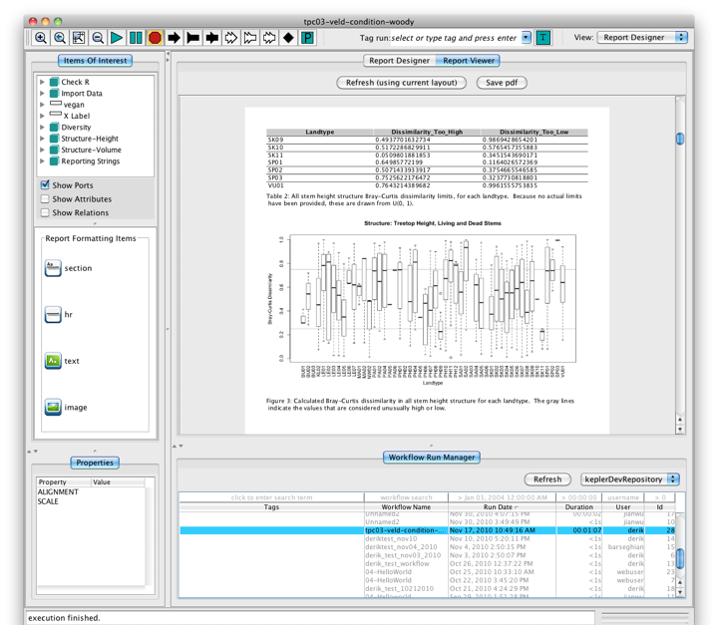
Viewing remote runs

Slide 25
Grid Computing

Slide 26
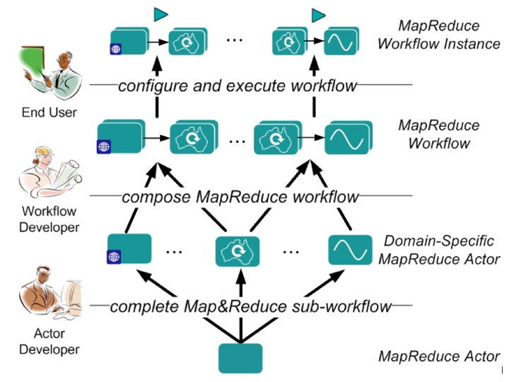
Grid computing
Support for several grid technologies
Ad-hoc Kepler networks (Master-Slave)
Globus grid jobs
Hadoop Map-Reduce
SSH plumbed-HPC

Slide 27
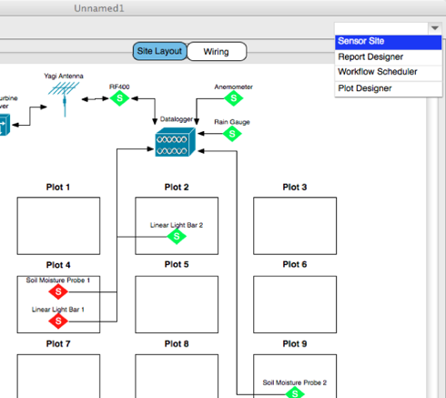
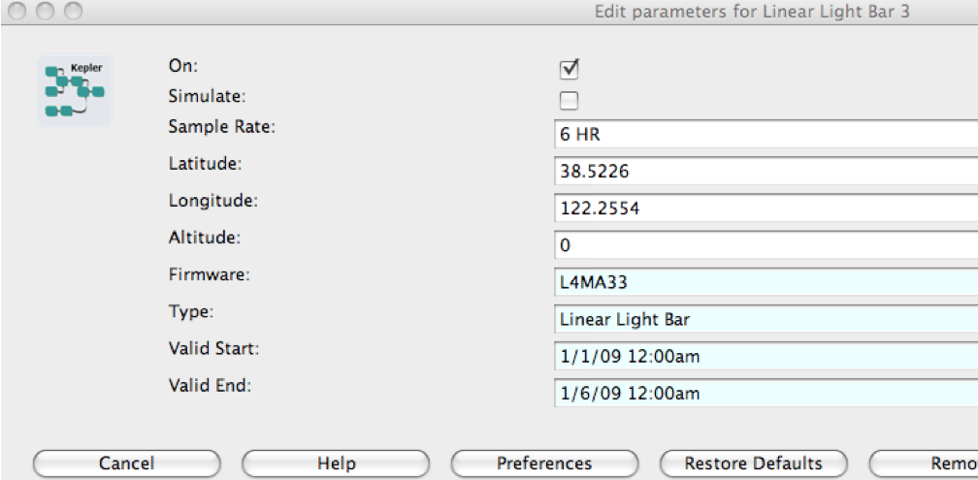
Sensor sites: topology and monitoring

Slide 28
Open Source Community

Slide 29



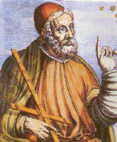







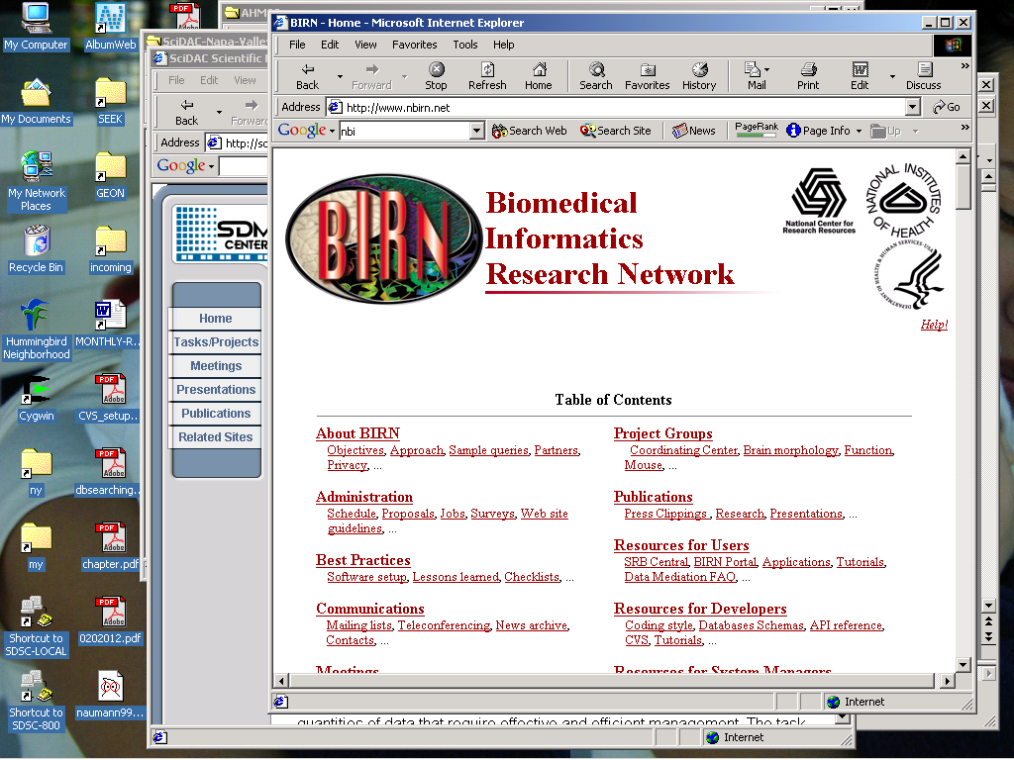
Open Kepler Collaboration
http://kepler-project.org
Open-source
BSD License
Collaborators
UCSB, UCD, UCSD, UCB, Gonzaga, many others
Ptolemy II

Slide 30
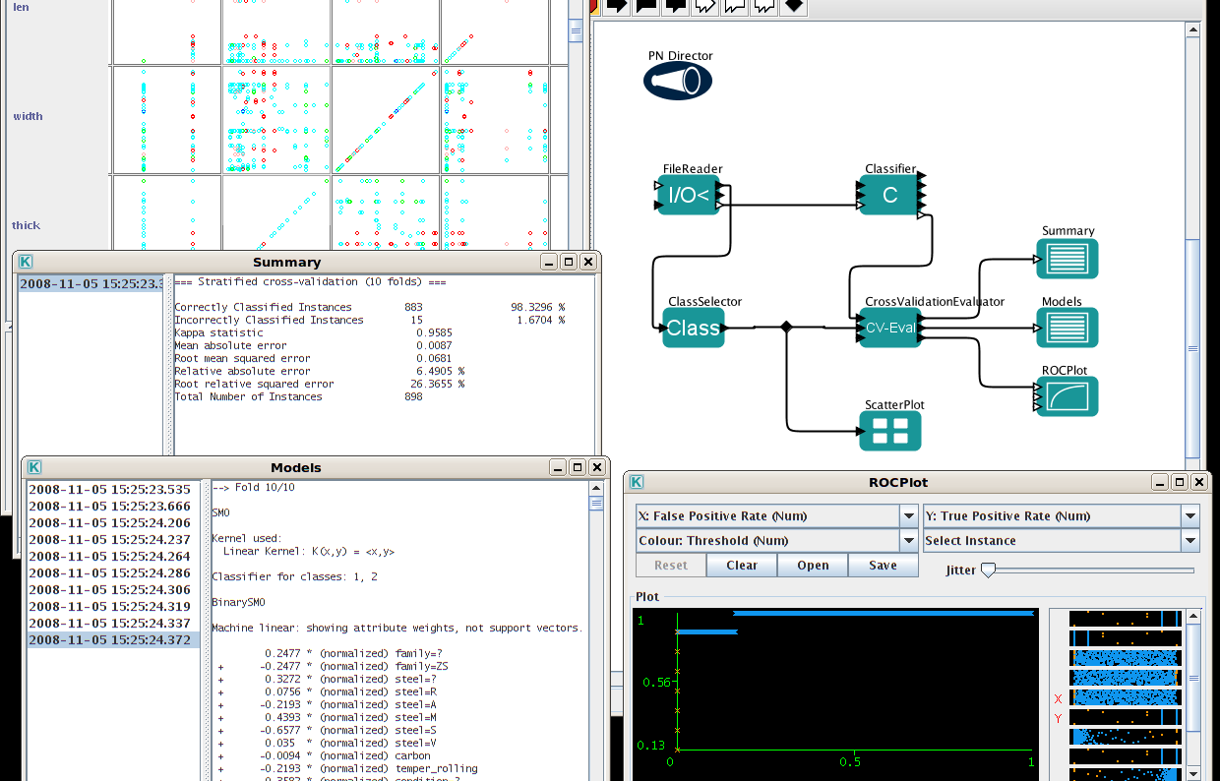
Community Contribution: Kepler/WEKA
from Peter Reutemann

Slide 31
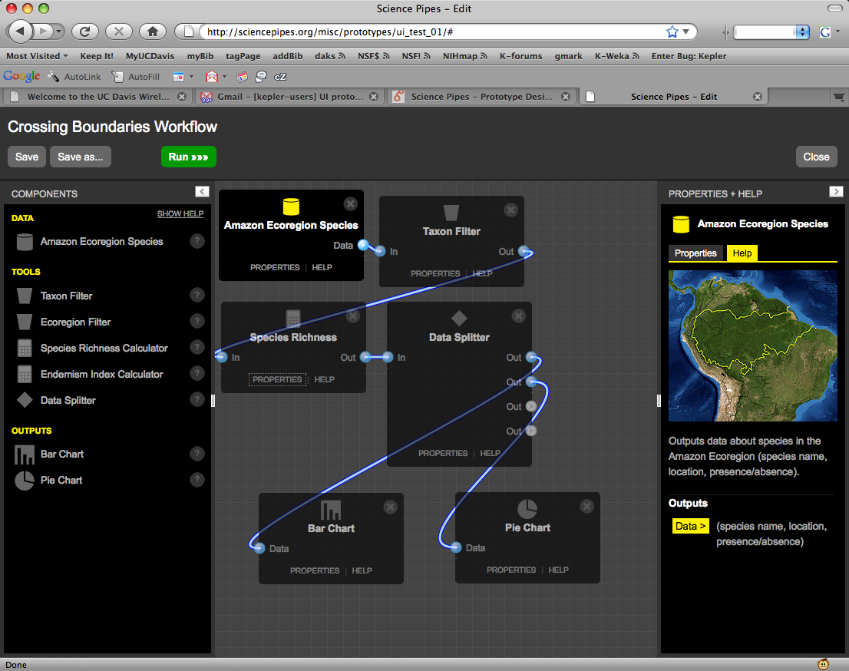
Community Contribution: Science Pipes
from Paul Allen, Cornell Lab of Ornithology

Slide 32
Advantages of Scientific Workflows
Mix analytical systems
Matlab, R, C code, FORTRAN, other executables, ...
Understand models
visually depict how the analysis works
Directly access data
Utilize Grid and Cloud computing
Share and version models
allow sharing of analytical procedures
document precise versions of data and models used
Provide provenance information
provenance is critical to science
workflows are metadata about scientific process

Slide 33
Other Workflow Systems

Slide 34

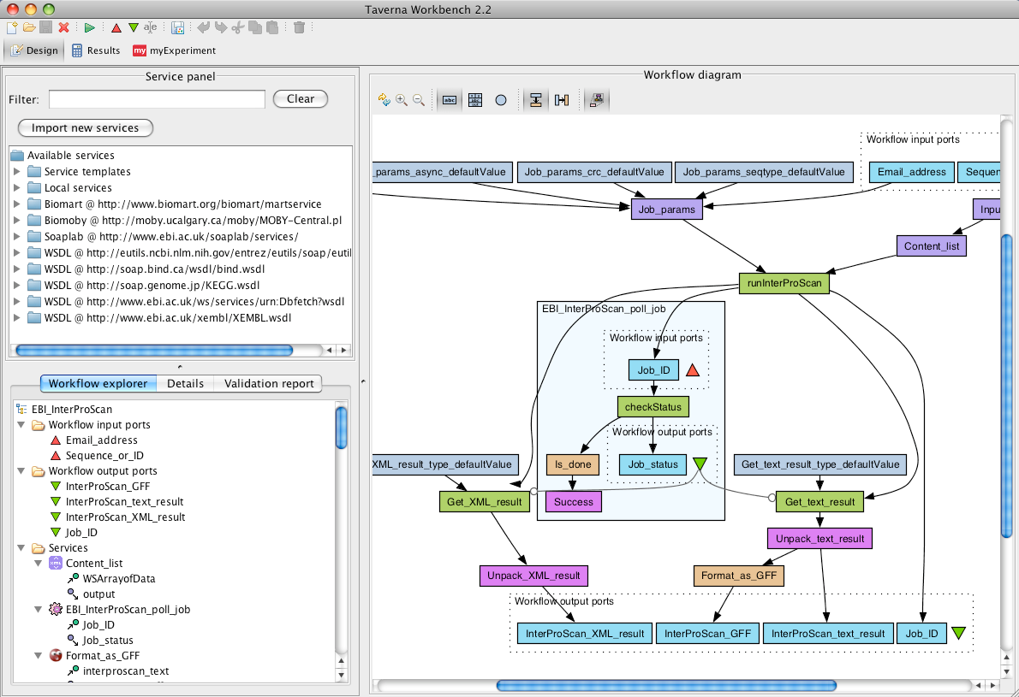
http://www.taverna.org.uk/
Taverna Workbench
Notes:
Especially in bioinformatics
Heavy reliance on web-services?

Slide 35

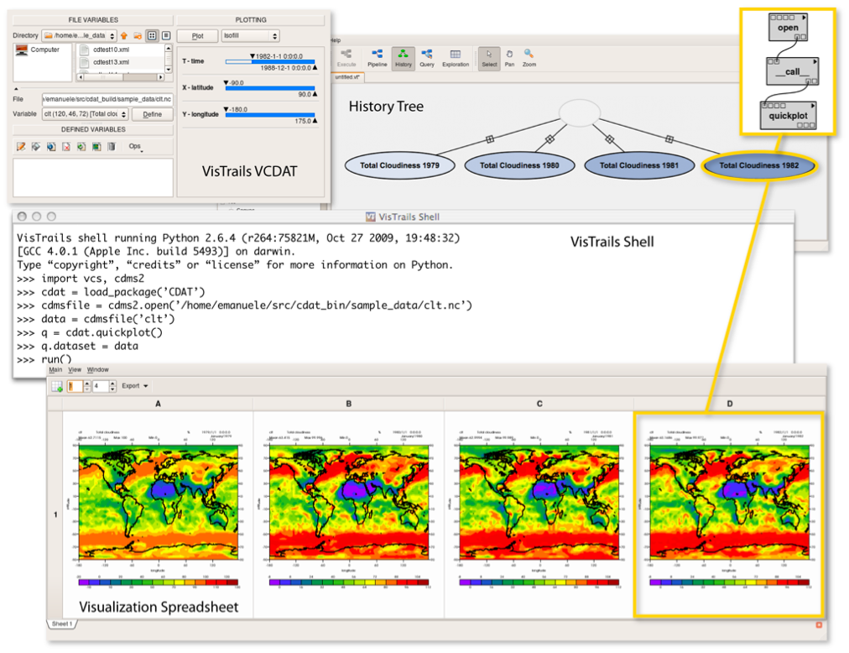
http://www.vistrails.org/
VisTrails
Notes:
Especially exploratory visualization
Nice built-in workflow versioning system

Slide 36

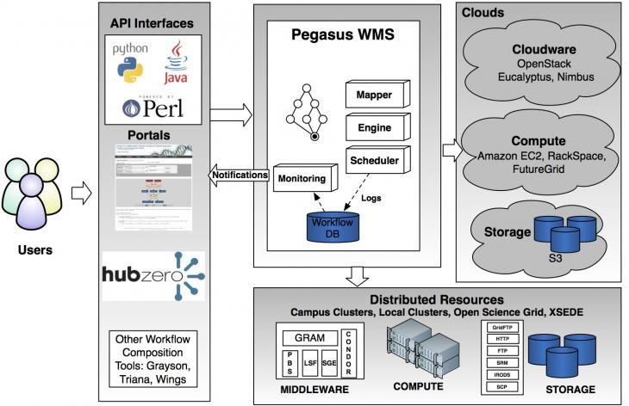
Pegasus

Slide 37

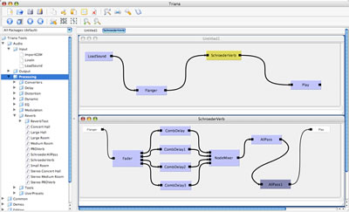
http://www.trianacode.org/
Triana
Notes:
Especially signal, text, image processing

Slide 38
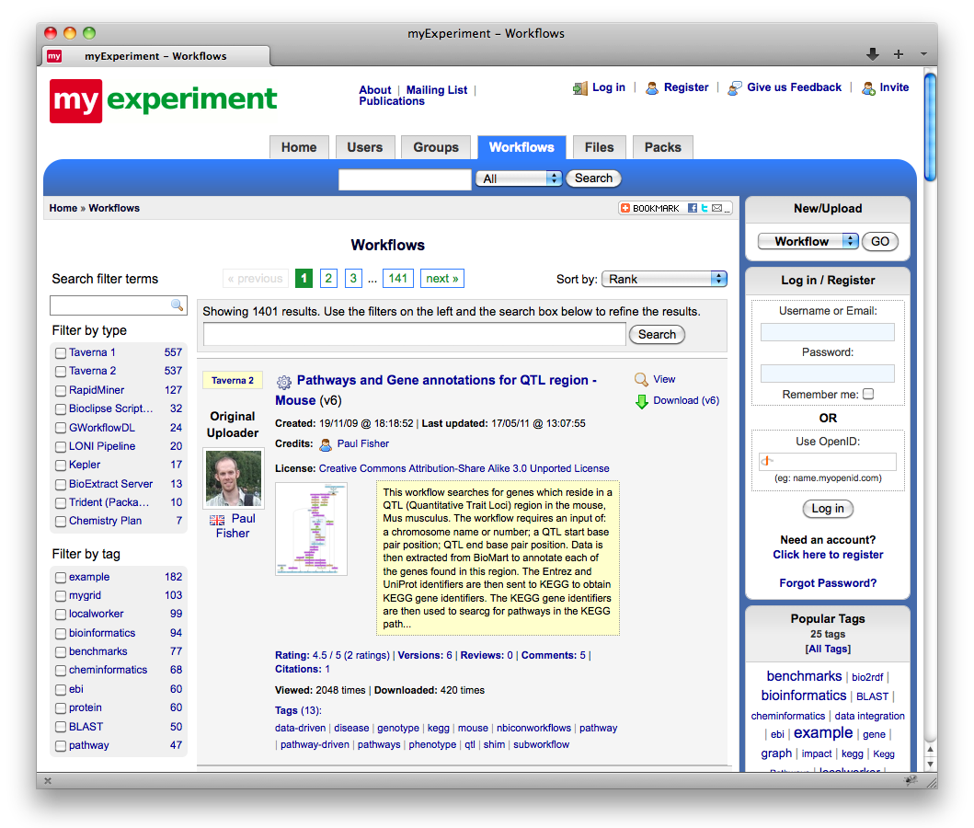
myexperiment.org
Notes:
Social networking meets workflow repository
Started out as a Taverna thing, but now supports other SWF systems

Slide 39
A case study:
Thresholds of Potential Concern (TPCs) from
Kruger National Park

Slide 40

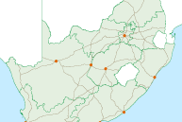
Kruger National Park
Flagship of the South African National Parks system
Established in 1898
Diverse ecosystems across nearly 2 million hectares

Slide 41
KNP Scientific Services
Plan and conduct conservation research
Identify and avert biodiversity threats
Provide scientific inputs to management
overabundance
invasives
pollutants
development
resource exploitation
climate change

Slide 42
Thresholds of Potential Concern (TPCs)
Upper/lower limits to environmental indicators
Based on long-term monitoring data quantifying variability in relevant factors
Used to determine whether pre-defined conditions have been exceeded
…so that management decisions can be made, and their empirical outcomes carefully documented
Notes:
TPCs reflect “best available knowledge and plausible ecological hypotheses around understanding complex dynamic ecosystems”.

Slide 43
Some TPC examples...
Animal populations
Acceptable densities and growth rates
Landscape/ecosystem types
Enough heterogeneity at various scales
Fires
Appropriate mix of size, intensity, location
River flow
Not too low; high with some frequency

Slide 44
TPC Exceedance
Exceedance of a TPC indicates an ecological condition within Kruger that is of serious concern

Slide 45
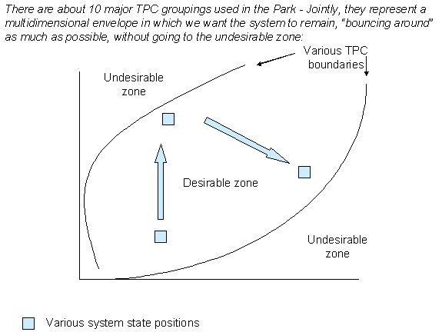
TPC Exceedance
http://www.sanparks.org/parks/kruger/conservation/scientific/mission/TPC.jpg

Slide 46
Practical Challenges of Implementing TPCs
Acquiring the necessary data
Interpreting and preprocessing the data
Faithfully implementing the TPC “rules”
Getting answers quickly and reliably
Translating results into recommendations
Ensuring transparency of the process

Slide 47
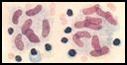
Bovine Tuberculosis (BTB)
Mycobacterium bovis
Invasive organism within African ecosystems
In KNP since early 1960s, likely originating from infected domestic cattle
Detected in ten wildlife species
buffalo, lion, leopard, cheetah, hyena, kudu, baboon, warthog, honey badger, genet
Buffalo are the primary host

Slide 48
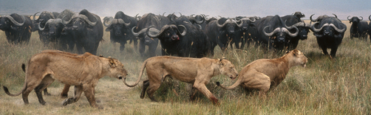
Bovine Tuberculosis (BTB)
Concern: BTB impacts on biodiversity
“Significant measured or predicted (through modeling) negative effects on population growth and structure, and long-term viability of a species that can be attributed to BTB”

Slide 49
The Buffalo BTB TPC
“A decline in zonal population growth rate to below 5% (normal growth rate 8% to 12%) in three consecutive years during a wet cycle, in a total buffalo population of less than 30 000”
wet cycle = “a mean annual rainfall for three consecutive years, including the year under consideration, above the long-term annual mean”

Slide 50
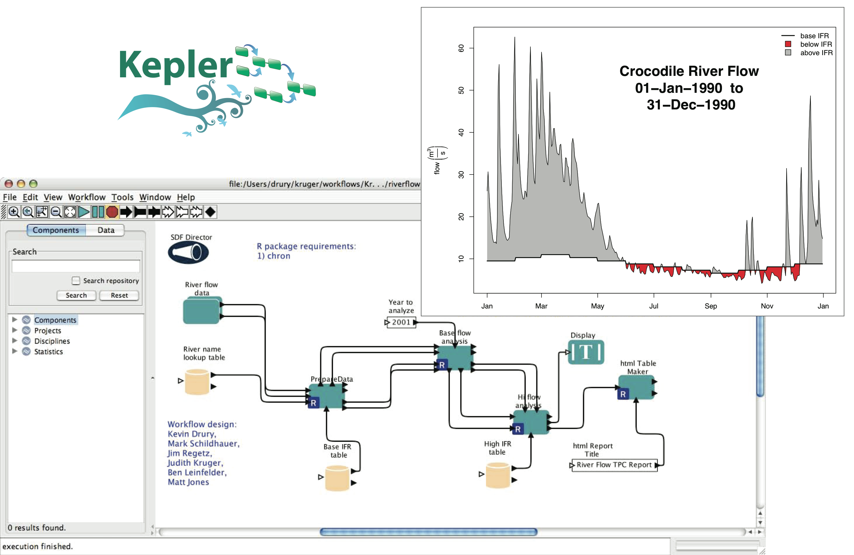
Scientific workflows document adaptive management

Slide 51
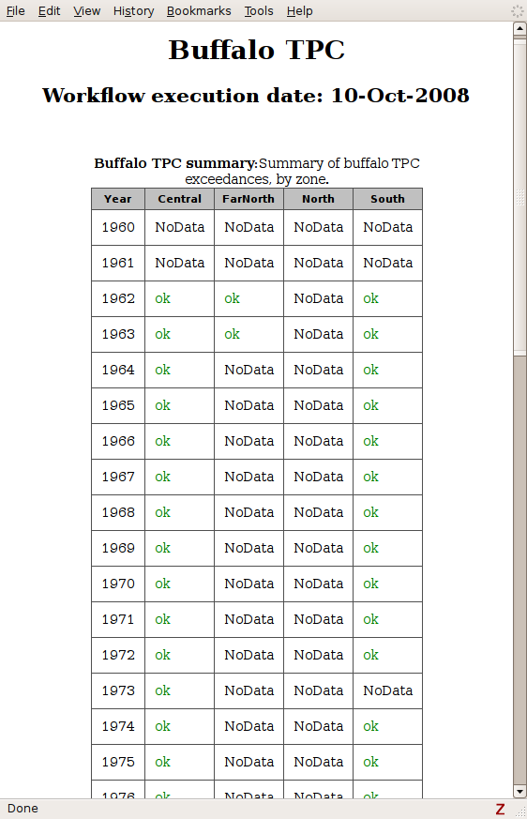
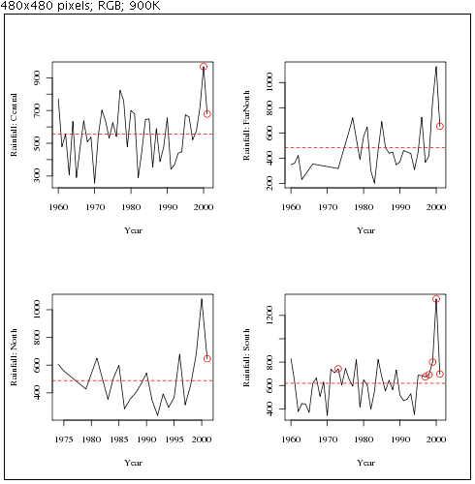
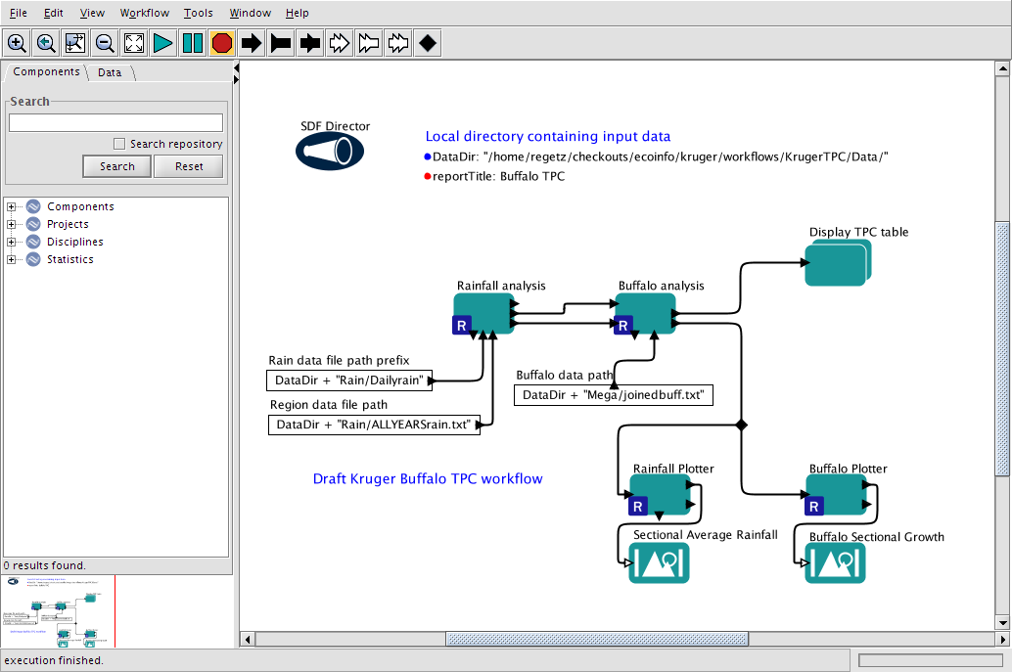
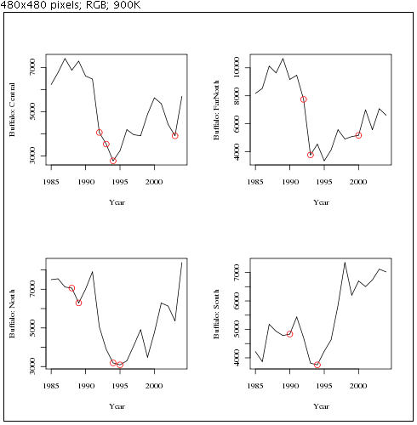
The Buffalo TPC
Data on local
hard drive
‘Wet cycle’
assessment
Buffalo
population
assessment
Display
results

Slide 52
Benefits of Kepler for TPCs
Visually depict how the TPC works
Clarify how execution takes place
Facilitate rapid review and revision
Provide direct access to data, via links to local or network storage
Execute TPCs on a schedule with new data
Enable efficient execution and sharing of results, even for those with minimal quantitative skills

Slide 53
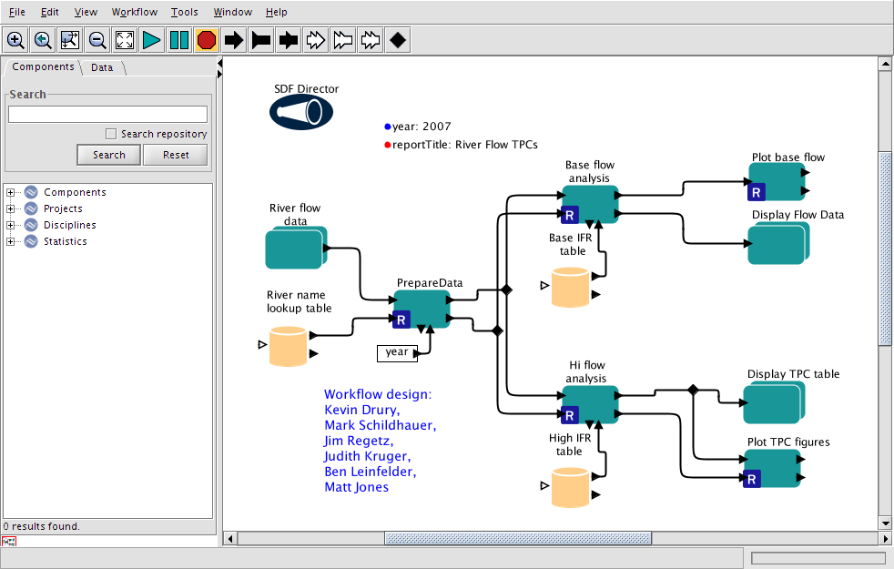
River Flow TPC
Data input from KNB
Data prep
TPC analysis
Base flow
High flow
Output display

Slide 54
River Flow TPC
Base flow
results
High flow
results

Slide 55
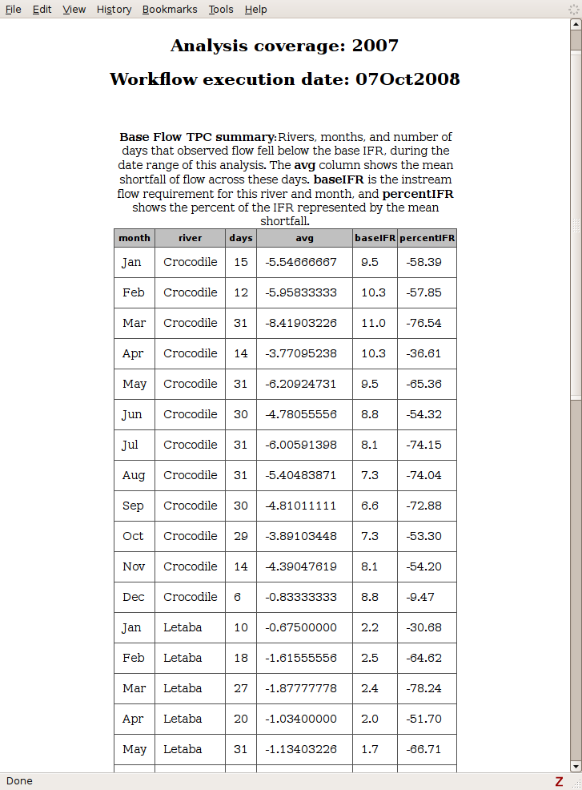
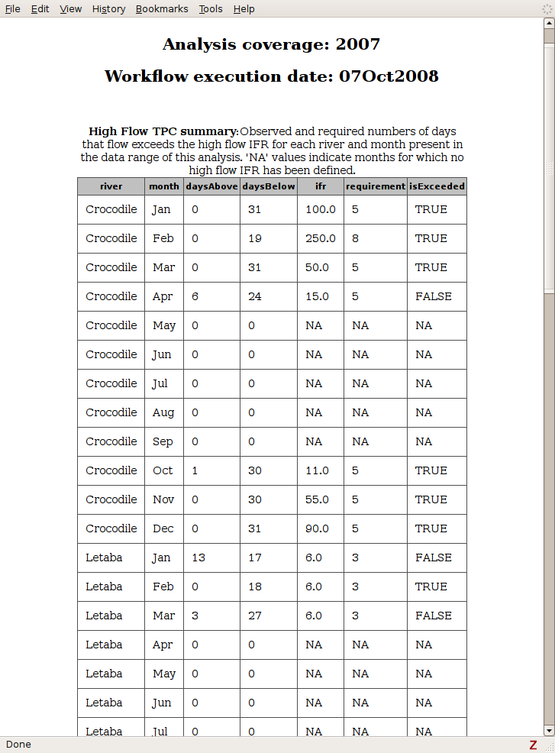
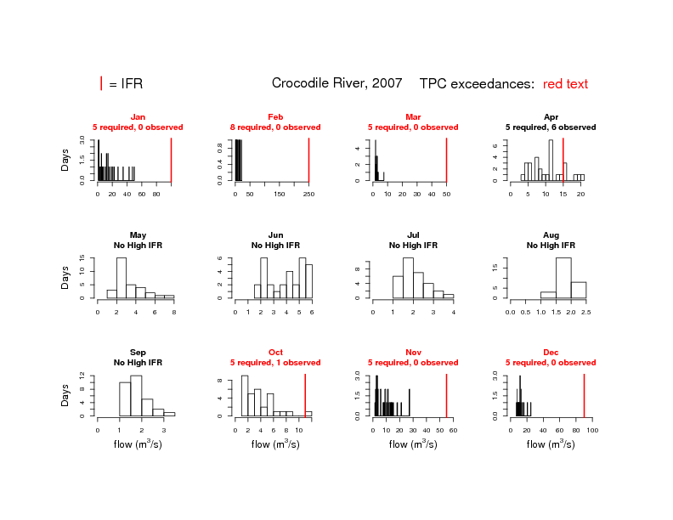
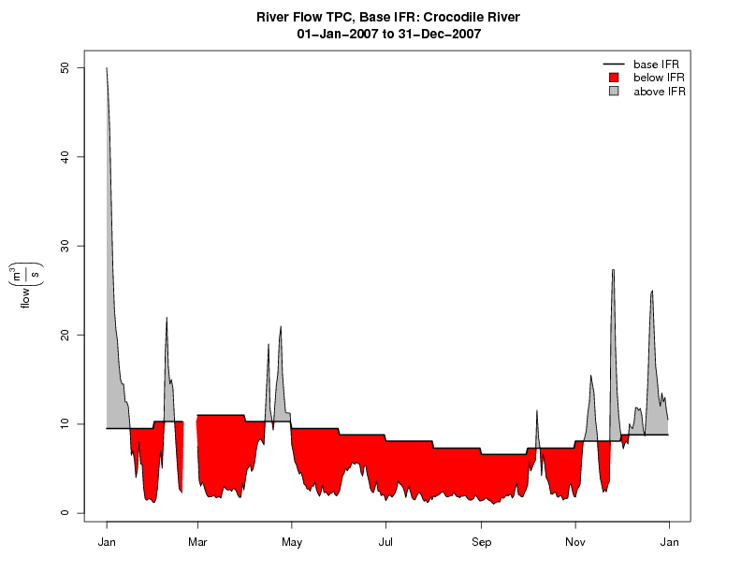
River Flow TPC
Base flow
results
High flow
results

Slide 56
In summary…
Typical analytical models are complex and difficult to comprehend and maintain
Scientific workflows provide
An intuitive visual model
Structure and efficiency in modeling and analysis
Abstractions to help deal with complexity
Direct access to data
Means to publish and share models
Kepler is an evolving but effective tool for scientists
Kepler/CORE award funds transition from research prototype to production software tool

